Slide 1
Powershell medley
Jonathan Allen

Slide 2
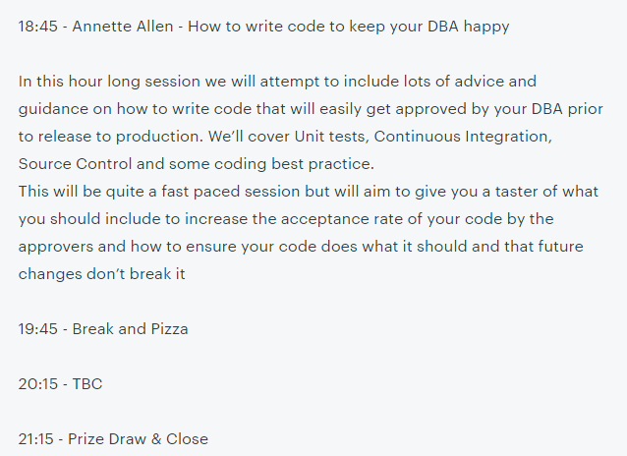

Your presenter is …

Slide 3
SOMETHING SOMETHING Powershell medley
Jonathan Allen

Slide 4
Jonathan
SQL Server DBA - 15 years
Microsoft SQL Server PFE - 3 years
SQLSouthWest user group founder

Slide 5
Powershell
01 Splatting
02 Customise your prompt
03 Event logs
04 Sysinternals
05 Custom input forms
06 Working with Windows Firewall
07 Building functions to help yourself
08 SQL Server Policy Based Management
09 Formatting values
10 Ensuring your code isn't altered
11 Getting it sorted
12 running a raffle
13 ISNULL
14 SQL Server vulnerability scans

Slide 6
01 Splatting
Making code more readable
Think about the person supporting the code after you
Because one day that person will be you

Slide 7
02 Custom PowerShell prompt
A handy place for useful information
https://gist.github.com/fatherjack/9c005403b2ffcd95ce5c30d1dc5213d6

Slide 8
03 Event Logs
Regular checks for Error and Warning entries
Filtering
Configuration

Slide 9
04 Sysinternals
Useful tools for windows admin tasks
Zoomit; desktops; process explorer; zoomit; hex2dec; RAMMap; TCPView
Often updated, revised

Slide 10

05 Custom input forms
"The console is all very well but if you want clarity you want a GUI"

Slide 11
06 Working with Windows Firewall
"My app isn't working is the firewall blocking it?"
"Probably, let's turn it off. That'll fix it."

Slide 12
07 Building functions to help yourself
Comments
Cmdlet binding
Parameters

Slide 13
08 Using SQL Server Policy Based Management
Leveraging the power of PBM

Slide 14
09 Formatting values
Making output look nice
And be useful

Slide 15
10 Ensuring your code isn't altered

Slide 16
11 Getting it sorted

Slide 17
12 Running a raffle

Slide 18
13 ISNULL
ISNULL in TSQL - returns a desired value if the tested value is null

Slide 19
14 SQL Server vulnerability scans
Not ready yet - come to SQLBits (hopefully) to see this content

Slide 20
Bonus - Snippets

Slide 21
Thank you / Questions / Contact / Raffle
Twitter @fatherjack
Blog https://blogs.technet.microsoft.com/dataplatform
Exeter user group https://www.meetup.com/SQL-South-West

